Slide 1

重庆大学 Chongqing University
Research Proposal of Chongqing University
The relationship between student’s GPA and their sleep length
Name：Sun Yingying
Prof. Zou Xiaoling
Academic Research Paper Writing
2021.06

Slide 2
Outline
重庆大学 Chongqing University
Research Background
Literature Review
Research Questions
Research Design/Methodology
Proposed timeframe
Expected outcome
Feasibility analysis
References

Slide 3
重庆大学 Chongqing University
1. Research Background
The importance of sleep
The widly concerned on the relationship between sleep and work
3.The current sleep problem around college students
4. Find a balance between sleep and higher GPA

Slide 4
重庆大学 Chongqing University
2. Literature Review
Poor Sleep Quality Exacerbates Psychomotor Performance
Associations between sleep and academic performance

Slide 5
重庆大学 Chongqing University
3. Research Questions
1. Do sleep length influence student's GPA
2. What is the balance between sleep length and higher GPA

Slide 6
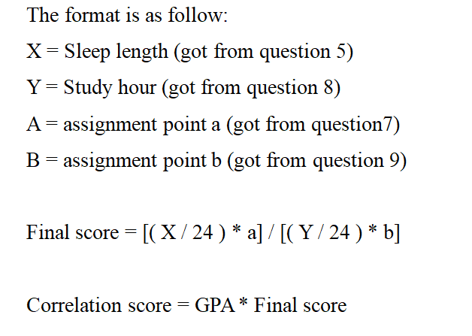
重庆大学 Chongqing University
4. Research Design/Methodology
a self-made scales
assigned socres to question 4 and 6(1,0.75,0.5,0.25)
Format
data analysis:
1.higher correlation score ---
his sleep length is more relevant to
his GPA.
2.percentage of high correlation,
medium correlation and
low correlation students

Slide 7
重庆大学 Chongqing University
5. Proposed timeframe
2021.6.1 ——2021.6.5 Preparation for the study, including questionnaire designed and analysis methods.
2021.6.5——2021.6.10 Distribute questionnaires and collect data
2021.6.10——2021.6.12 Data analysis by using the self-designed methodology.
2021.6.12——2021.6.16 Reach the conclusion and finish the research paper.

Slide 8
重庆大学 Chongqing University
6. Expected outcome
the number of high correlation students will be most
sleep length do correlate with students’ GPA
sleep time for 7-8 hours,with study time about 10 hours everyday
4. provide a balance for students to reduce the rate of sudden death, mental or physical problems.

Slide 9
重庆大学 Chongqing University
7. Feasibility analysis
based on previous researches aiming to find out the relationship between work efficiency and sleep quality and length.
2. necessary preparation includes current situation and relevant reference
3. other factors that can have influence
4. research subjects not wide enough
5.self-made format may not be perfect and accurate enough

Slide 10
重庆大学 Chongqing University
8. References
Yavuz Selvi et al. The effects of individual biological rhythm differences on sleep quality, daytime sleepiness, and dissociative experiences[J]. Psychiatry Research, 2017, 256 : 243-248.
Asawa Kailash et al. Influence of sleep disturbance, fatigue, vitality on oral health and academic performance in indian dental students.[J]. Clujul medical (1957), 2017, 90(3) : 333-343.
Di Muzio Marco et al. Nurses and Night Shifts: Poor Sleep Quality Exacerbates Psychomotor Performance.[J]. Frontiers in neuroscience, 2020, 14 : 579938-579938.
Begdache Lina et al. Dynamic Association between Daily Alternate Healthy Eating Index, Exercise, Sleep, Seasonal Change and Mental Distress among Young and Mature Men and Women[J]. Journal of Affective Disorders Reports, 2021, : 100157-.
........too much to list all of them

Slide 11
重庆大学 Chongqing University
Thank you very much for your advice!

